Slide 1

Faculty Development Program on Machine Learning
By: Jaya Gupta, Assistant Professor -IT
Organized by Department of Information Technology

Slide 2

Machine Learning in Recent News Feeds

Slide 3
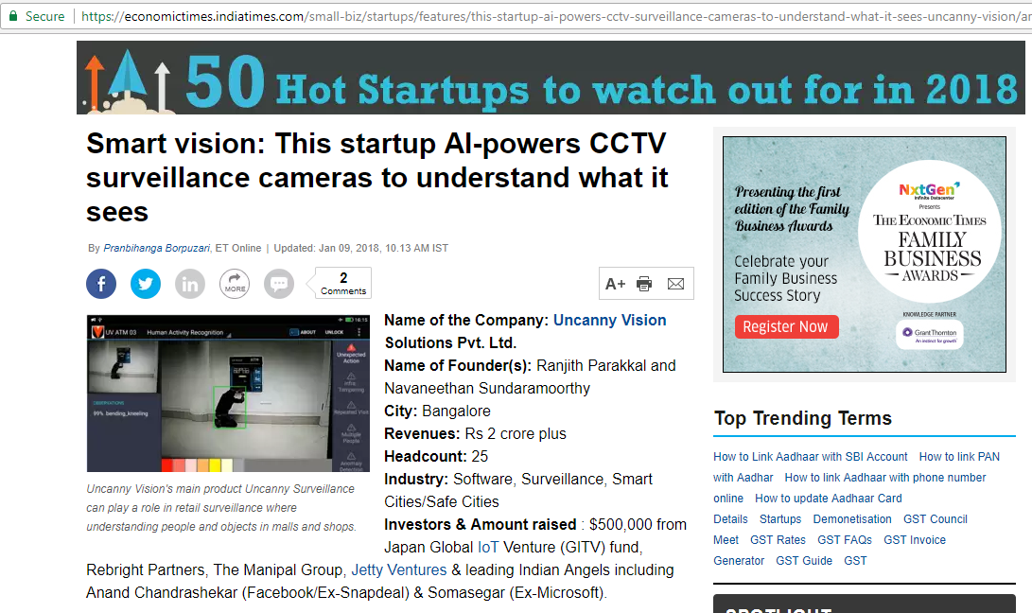

Slide 4
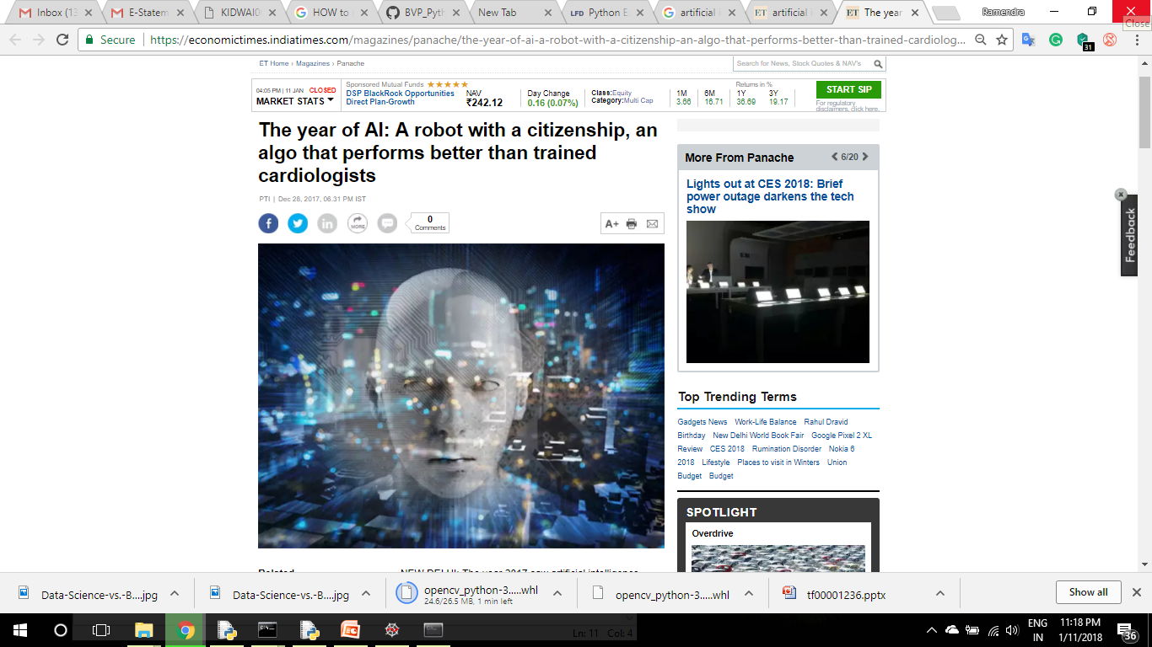

Slide 5
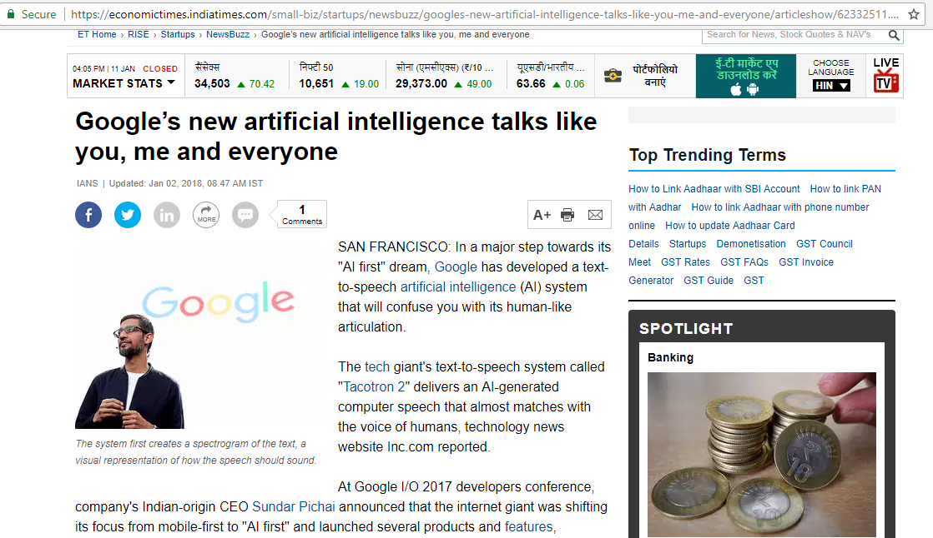

Slide 6
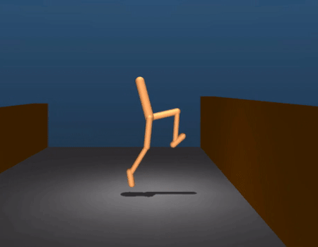

Applications of Machine Learning
Meet the DrunkBots: DeepMind researchers trained simulated bodies to navigate different terrains
Hilarious footage from the study shows how they learn to improve techniques

Slide 7
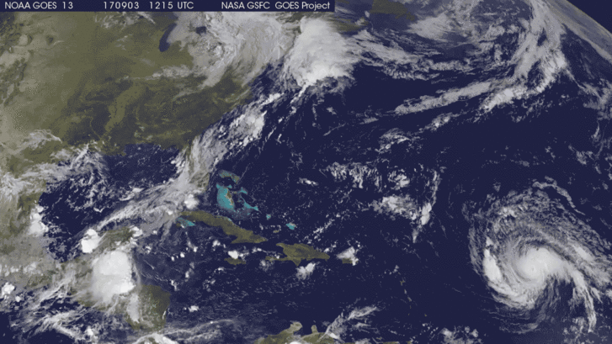
Weather Forecasting

Slide 8
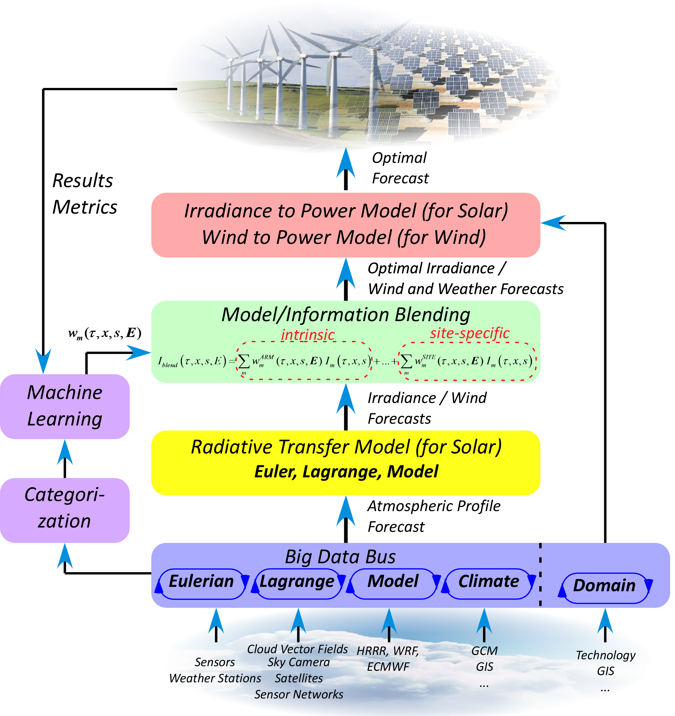
Complex ML Model For Weather Forecasting

Slide 9

Weather Forecasting

Slide 10


Hand Written Digit Recognition
Yann LeCun, Director of AI Research, Facebook

Slide 11

Hand Written Digit Recognition

Slide 12
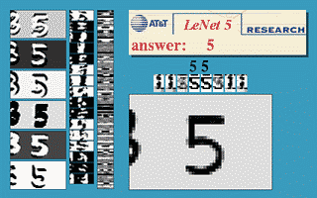
Hand Written Digit Recognition

Slide 13
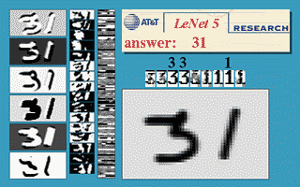
Hand Written Digit Recognition

Slide 14
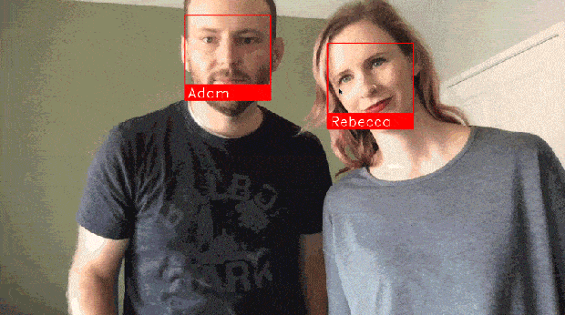
Face Recognition

Slide 15
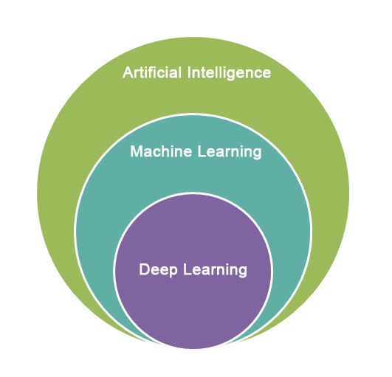
Artificial Intelligence is concerned with the design of intelligence in an artificial device.
The term was coined by McCarthy in 1956.
Machine Learning is the field of study of computer science that gives computers the ability to learn without being explicitly programmed.
Arthur Samuel(1959)
Deep learning is an algorithm which has no theoretical limitations of what it can learn ; the more data you give and the more computational time you provide, the better it is.
Geoffrey Hinton(Google)

Slide 16
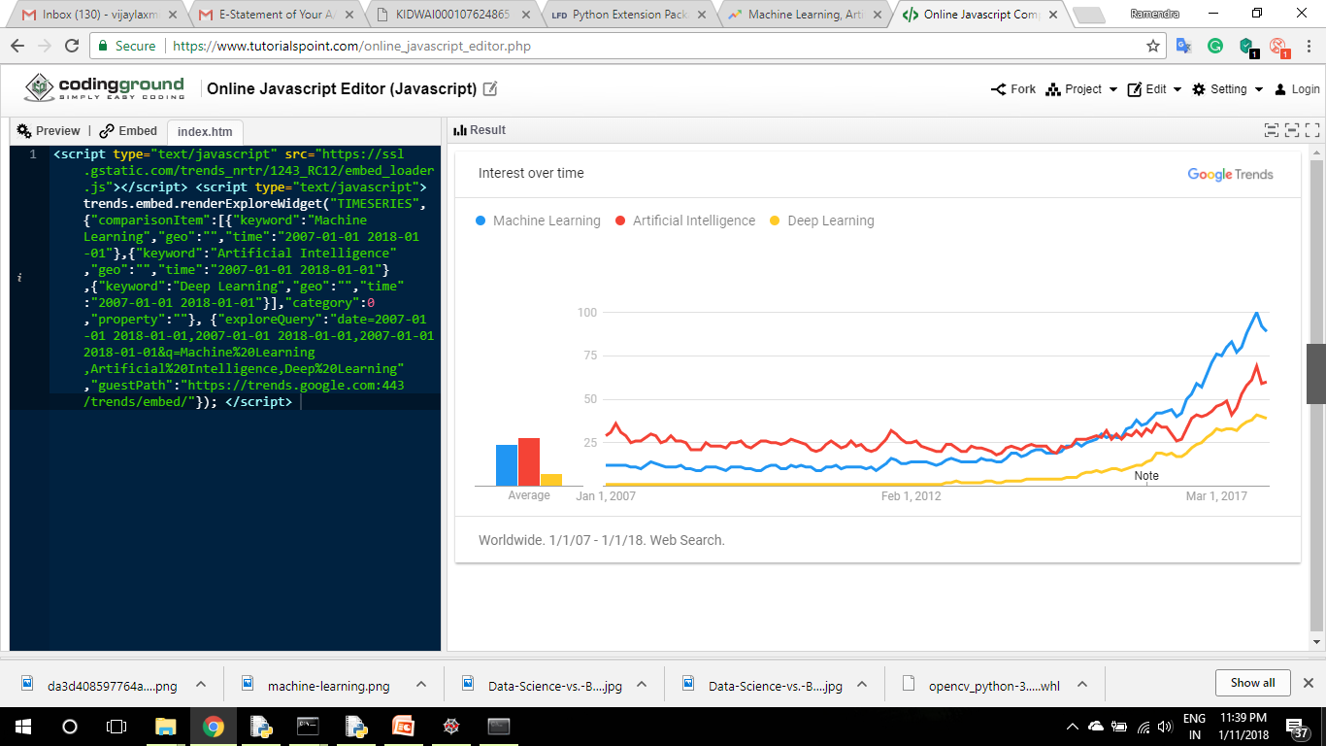
Google Trends

Slide 17
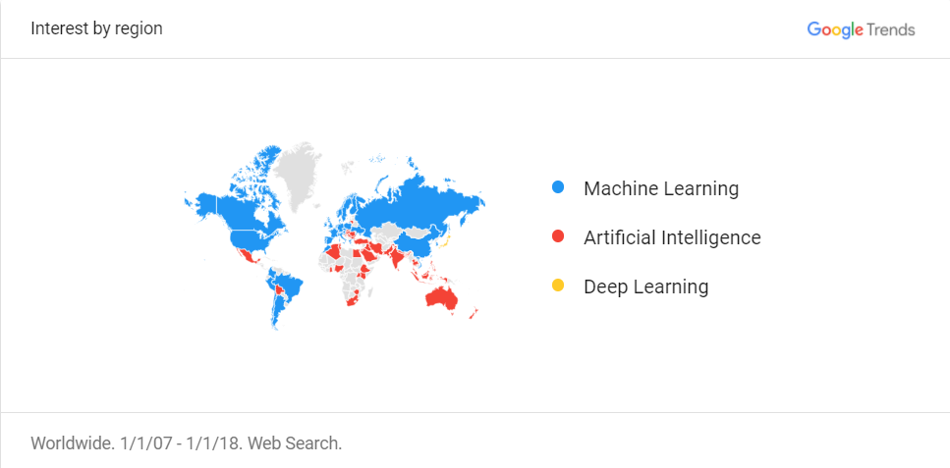
Google Trends

Slide 18


Slide 19
What is Learning?

Slide 20


Slide 21


Slide 22



Slide 23
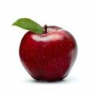
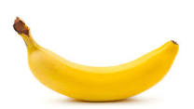

Slide 24
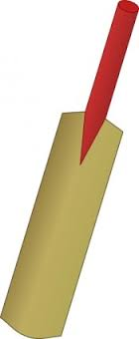

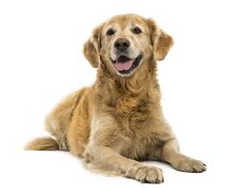

Slide 25
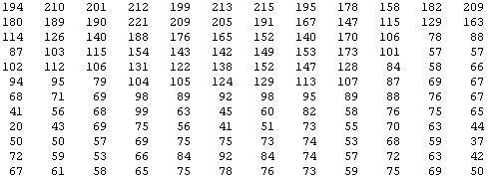
What We See :
What camera sees this:

Slide 26
How Machine Will Learn?
Now the Question is--

Slide 27
Machine Learning Formal Definition
Arthur Samuel(1959)
Field of study that gives computers the ability to learn without being explicitly programmed.
Tom Mitchell(1998)
A computer program is said to learn from experience E with respect to some class of tasks T and performance measure P, if its performance at tasks in T, as measured by P, improves with experience E.

Slide 28
Tom Mitchell Definition
Suppose your email program watches which emails you do or do not mark as spam, and based on that learns how to better filter spam. What is the task T, Experience E and Performance Measure P in this setting?
Classifying emails as spam or not spam. (T)
Watching you label emails as spam or not spam. (E)
The number (or fraction) of emails correctly classified as spam/not spam. (P)

Slide 29
Machine Learning Outline
“A Breakthrough in machine leaning would be Worth Ten Microsofts”
-Bill Gates
Supervised Learning
Regression
Linear Regression
Classification
Decision Tree
KNN
Naïve Bayes Classifier
Support Vector Machine
Unsupervised Learning

Slide 30
Python Hands-on

Slide 31
Supervised Learning
In supervised leaning the teacher is present which provides the desired action corresponding to a perception.
For Given
f:x→y
Classification
Regression
If y is discrete/categorical variable
If y is real number/continuous value

Slide 32
Regression Example
Training set of
housing prices
(Portland, OR)
Size in feet² (x) | Price ($) in 1000's (y)
2104 | 460
1416 | 232
1534 | 315
852 | 178
… | …
m
Notation:
m = Number of training examples
x’s = “input” variable / features
y’s = “output” variable / “target” variable
x⁽¹⁾ = 2104
x⁽²⁾ = 1416
y⁽¹⁾ = 460
(x, y) – one training example
(x^{(i)}, y^{(i)}) – ith training example

Slide 33
Housing Prices
(Portland, OR)
220
Price
(in 1000s of dollars)
1250
Size (feet²)
Supervised Learning
Given the “right answer” for each example in the data.
Regression Problem
Predict real-valued output
Classification : Discrete-valued output

Slide 34
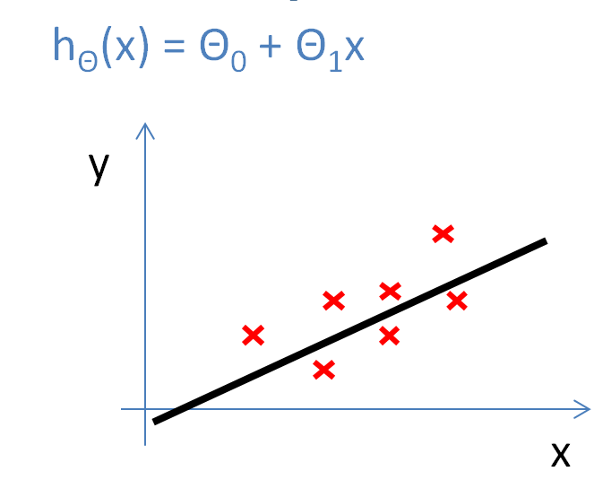
Training Set
How do we represent h ?
Learning Algorithm
Size of house
h
Estimated price
x
hypothesis
Estimated
value
Linear regression with one variable.
Univariate linear regression.
h maps from x’s to y’s
One variable

Slide 35
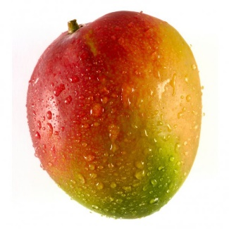
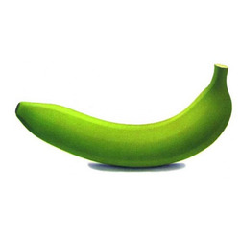
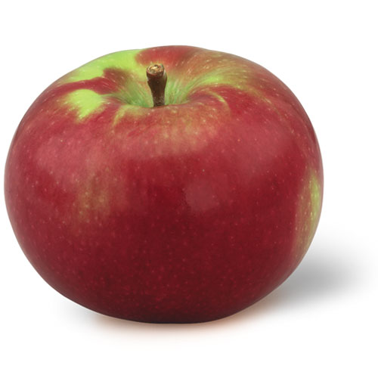
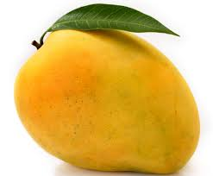
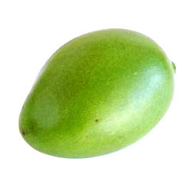
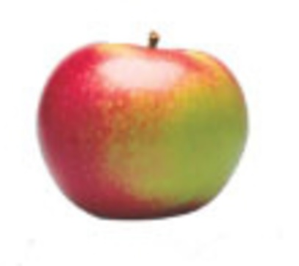
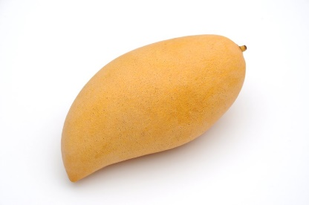
Classification Example

Slide 36
Classification Example
Name of Fruit
Apple
Banana
Mango

Slide 37
Classification Example
Name of Fruit
Apple
Banana
Mango
f(Fruit) Name of Fruit

Slide 38
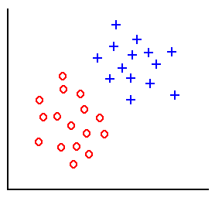
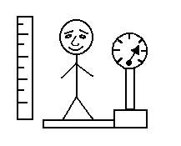
Classification Example
height
weight
Training examples
Linear classifier:
D_{i} = distance(x, x_{i}), i=1,2,…,l

Slide 39
Machine Learning Outline
“A Breakthrough in machine leaning would be Worth Ten Microsofts”
-Bill Gates
Supervised Learning
Classification
Decision Tree
K-Nearest Neighbours
Naïve Bayes Classifier
Support Vector Machine
Regression
Linear Regression
Unsupervised Learning

Slide 40
Task -1
Take simple data and perform classification of data by using Decision Tree Classifier
Tools Required : python(3.6)/Anaconda3
Libraries Required: Sklearn python library

Slide 41
Play Tennis ?
Day
Outlook
Temp.
Humidity
Wind
Play Tennis
D1
Sunny
Hot
High
Weak
No
D2
Sunny
Hot
High
Strong
No
D3
Overcast
Hot
High
Weak
Yes
D4
Rain
Mild
High
Weak
Yes
D5
Rain
Cool
Normal
Weak
Yes
D6
Rain
Cool
Normal
Strong
No
D7
Overcast
Cool
Normal
Weak
Yes
D8
Sunny
Mild
High
Weak
No
D9
Sunny
Cold
Normal
Weak
Yes
D10
Rain
Mild
Normal
Strong
Yes
D11
Sunny
Mild
Normal
Strong
Yes
D12
Overcast
Mild
High
Strong
Yes
D13
Overcast
Hot
Normal
Weak
Yes
D14
Rain
Mild
High
Strong
No

Slide 42
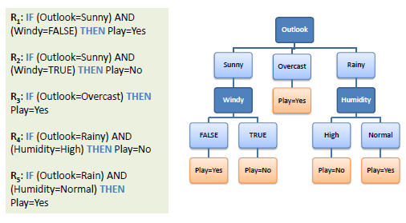
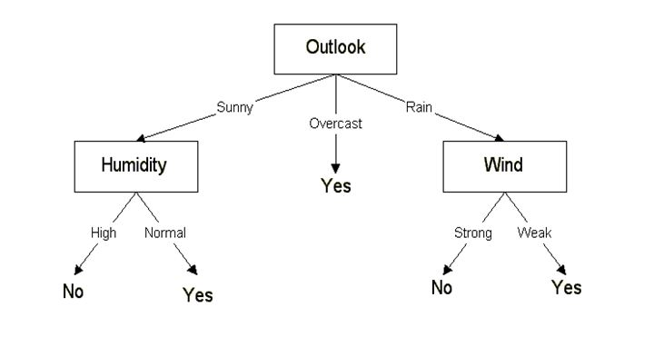
How Decision Tree Classify
Class: 1(Positive Class)
Class: 2(Negative Class)

Slide 43
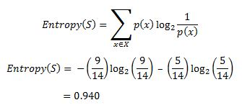
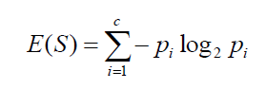
Conceptual Approach
Now we’ll go ahead and grow the decision tree. The initial step is to calculate H(S), the Entropy of the current state. In the above example, we can see in total there are 5 No’s and 9 Yes’s.
next step is to choose the attribute that gives us highest possible Information Gain which we’ll choose as the root node.
Yes | No | Total
9 | 5 | 14
or

Slide 44
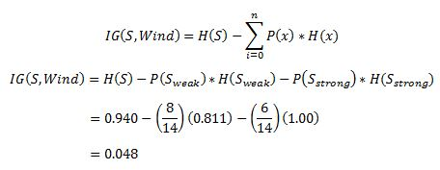
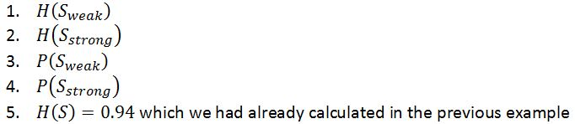
Decision Tree
Let’s start with ‘Wind’ , where ‘x’ are the possible values for an attribute. Here, attribute ‘Wind’ takes two possible values in the sample data, hence x = {Weak, Strong}
Amongst all the 14 examples we have 8 places where the wind is weak and 6 where the wind is Strong

Slide 45
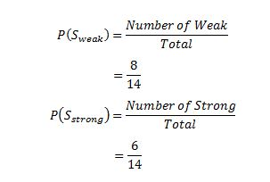
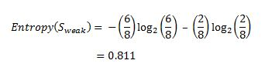
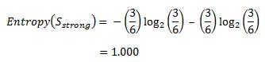
Decision Tree
Now out of the 8 Weak examples, 6 of them were ‘Yes’ for Play Tennis and 2 of them were ‘No’ for ‘Play Tennis’. So, we have,
Similarly, out of 6 Strong examples, we have 3 examples where the outcome was ‘Yes’ for Play Tennis and 3 where we had ‘No’ for Play Tennis.
Wind = Weak | Wind = Strong | Total
8 | 6 | 14

Slide 46
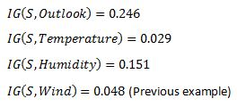
Decision Tree
Now we have all the pieces required to calculate the Information Gain,
Which tells us the Information Gain by considering ‘Wind’ as the feature and give us information gain of 0.048. Now we must similarly calculate the Information Gain for all the features.

Slide 47
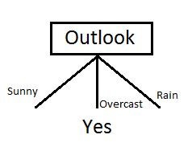
Decision Tree
We can clearly see that IG(S, Outlook) has the highest information gain of 0.246, hence we chose Outlook attribute as the root node. At this point, the decision tree looks like.
Now, we had three possible values of Outlook: Sunny, Overcast, Rain. Where the Overcast node already ended up having leaf node ‘Yes’, so we’re left with two subtrees to compute: Sunny and Rain.

Slide 48
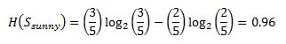
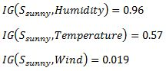
Decision Tree
Temperature | Humidity | Wind | Play Tennis
Hot | High | Weak | No
Hot | High | Strong | No
Mild | High | Weak | No
Cool | Normal | Weak | Yes
Mild | Normal | Strong | Yes
Table where the value of Outlook is Sunny looks like:
In the similar fashion, we compute the following values
As we can see the highest Information Gain is given by Humidity. Proceeding in the same way will give us Wind as the one with highest information gain.

Slide 49
Decision Tree
The final Decision Tree looks something like this.

Slide 50
Take an standard input dataset and perform classification of data by using Decision Tree Classifier and also create a Decision tree for corresponding input
Task -2
Tools Required : python(3.6)/Anaconda3
Libraries Required: Sklearn, Pydotplus python library
Graphviz MSI installer

Slide 51
Machine Learning Outline
“A Breakthrough in machine leaning would be Worth Ten Microsofts”
-Bill Gates
Supervised Learning
Classification
Decision Tree
K-Nearest Neighbours
Naïve Bayes Classifier
Support Vector Machine
Regression
Linear Regression
Unsupervised Learning

Slide 52
Take an standard input dataset and perform classification of data by using KNN Classifier.
Task -3
Tools Required : python(3.6)/Anaconda3
Libraries Required: Sklearn python library

Slide 53
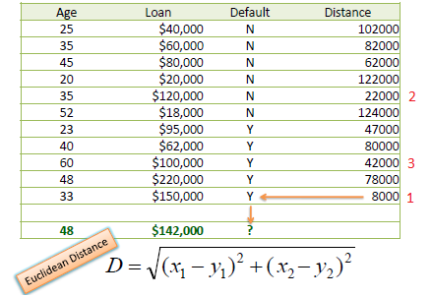
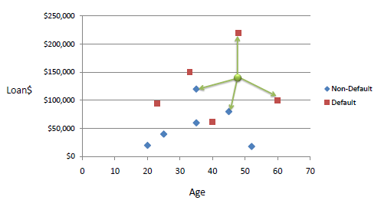
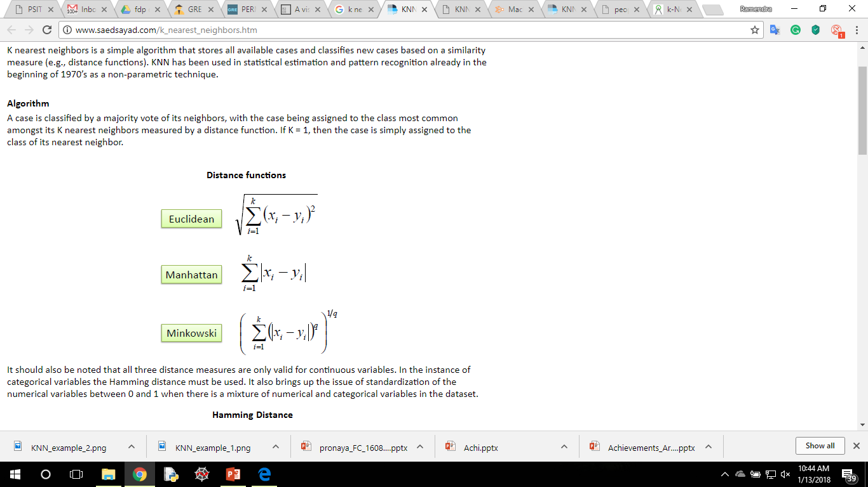
K-Nearest Neighbors
48 | $142,000 | ?
K nearest neighbors is a simple algorithm that stores all available cases and classifies new cases based on a similarity measure (e.g., distance functions).
Example:
Consider the following data concerning credit default. Age and Loan are two numerical variables (predictors) and Default is the target.
2
3
1
x₁
48 | $142,000 | ?
x₂
D₁ = Sqrt[(48-33)^2 + (142000-150000)^2]
http://www.saedsayad.com/flash/KNN_flash.html
http://ml-playground.com

Slide 54
Machine Learning Outline
“A Breakthrough in machine leaning would be Worth Ten Microsofts”
-Bill Gates
Supervised Learning
Classification
Decision Tree
K-Nearest Neighbours
Naïve Bayes Classifier
Support Vector Machine
Regression
Linear Regression
Unsupervised Learning

Slide 55
Take an standard input dataset and perform classification of data by using Naïve Bayes Classifier.
Task -4
Tools Required : python(3.6)/Anaconda3
Libraries Required: Sklearn python library

Slide 56
Naïve Bayes Classifier
Naive Bayes is a collection of classification algorithms based on Bayes Theorem. It is not a single algorithm but a family of algorithms that all share a common principle, that every feature being classified is independent of the value of any other feature.
For example, a fruit may be considered to be an apple if it is red, round, and about 3 inches in diameter. Even if these features depend on each other or upon the existence of the other features, all of these properties independently contribute to the probability that this fruit is an apple and that is why it is known as ‘Naive’.
In a nutshell, the algorithm allows us to predict a class, given a set of features using probability.
Lets Understand Bayes Therorm First :

Slide 57
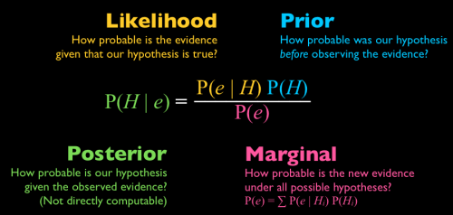
Bayes Theorem

Slide 58
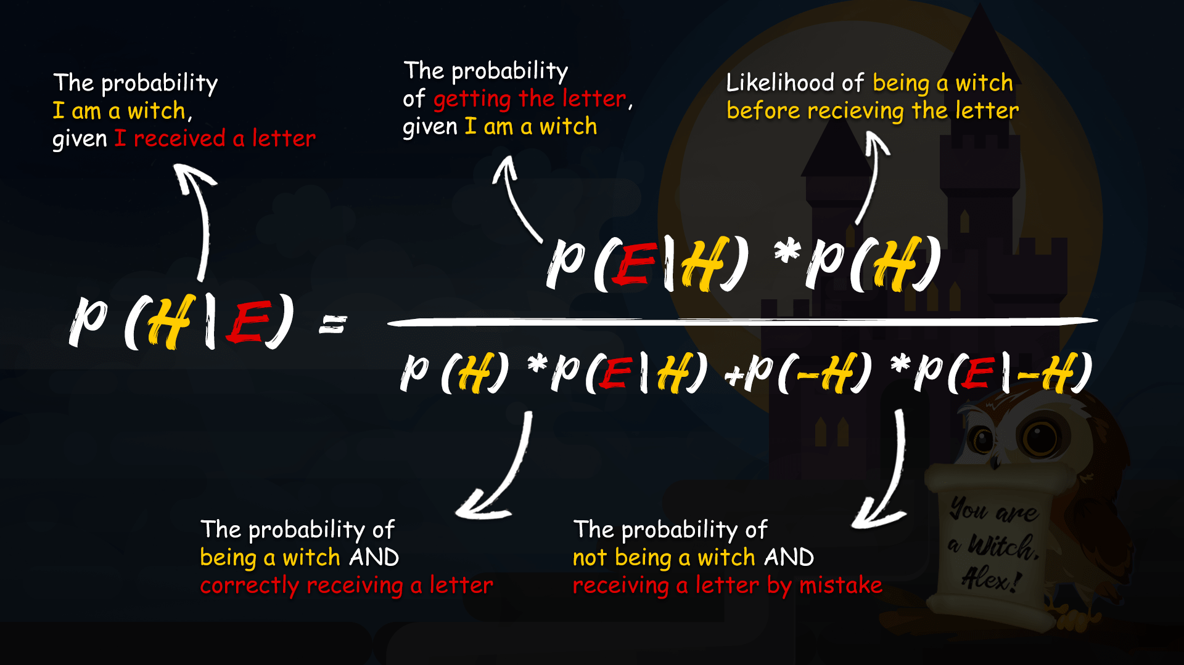
Extended Bayes Theorem

Slide 59
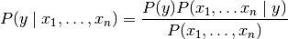
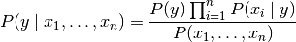
Naïve Bayes Classifier
Naive Bayes methods are a set of supervised learning algorithms based on applying Bayes’ theorem with the “naive” assumption of independence between every pair of features.
Given a class variable y and a dependent feature vector x₁ through x_{n}, Bayes’ theorem states the following relationship:
Using the naive independence assumption that:
for all i, this relationship is simplified to :

Slide 60
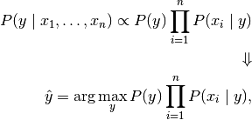
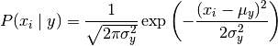
Naïve Bayes Classifier
Since is constant given the input, we can use the following classification rule:
In Gaussian Naïve Bayes Classification, the likelihood of the features is assumed to be Gaussian:

Slide 61
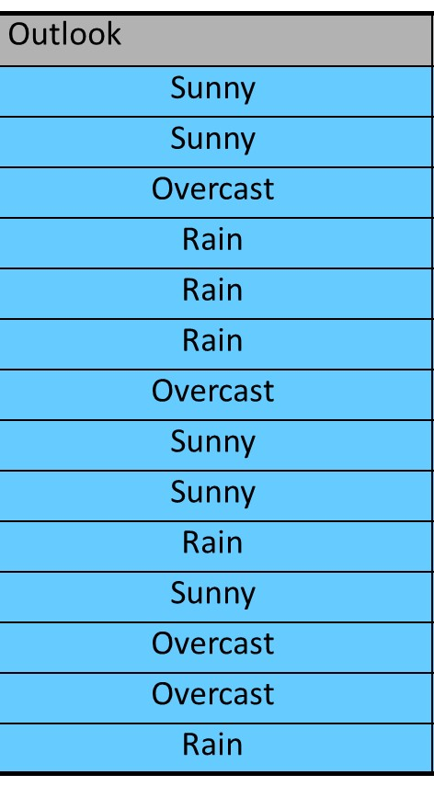


Example of Naïve Bayes Classifier
Lets say we have a training data set of weather and corresponding target variable ‘Play’ (suggesting possibilities of playing). Now, we need to classify whether players will play or not based on weather condition.
Problem: Players will play if weather is sunny. Is this statement is correct?

Slide 62
Machine Learning Outline
“A Breakthrough in machine leaning would be Worth Ten Microsofts”
-Bill Gates
Supervised Learning
Classification
Decision Tree
K-Nearest Neighbours
Naïve Bayes Classifier
Support Vector Machine
Regression
Linear Regression
Unsupervised Learning

Slide 63
Take an standard input dataset and Compare the Accuracy Scores of Decision Tee, KNN, Naïve Bayes classification.
Task -5
Tools Required : python(3.6)/Anaconda3
Libraries Required: Sklearn python library

Slide 64
Take MNIST dataset and predict the class labels by using KNN Classifier and check performance measure by using Confusion Matrix.
Task -6
Tools Required : python(3.6)/Anaconda3
Libraries Required: Sklearn , NUMPY, MatplotLiB, python library

Slide 65
Machine Learning Outline
“A Breakthrough in machine leaning would be Worth Ten Microsofts”
-Bill Gates
Supervised Learning
Classification
Decision Tree
K-Nearest Neighbours
Naïve Bayes Classifier
Support Vector Machine
Regression
Linear Regression
Unsupervised Learning

Slide 66
Take MNIST dataset and predict the class labels by using Support Vector Machines (SVM) Classifier
Task -7
Tools Required : python(3.6)/Anaconda3
Libraries Required: Sklearn , NUMPY, MatplotLiB, python library

Slide 67
Support Vector Machine
“Support Vector Machine” (SVM) is a supervised machine learning algorithm which can be used for both classification or regression challenges.
However, it is mostly used in classification problems. In this algorithm, we plot each data item as a point in n-dimensional space (where n is number of features you have) with the value of each feature being the value of a particular coordinate. Then, we perform classification by finding the hyper-plane that differentiate the two classes very well.

Slide 68

Separating Hyperplane
A separating hypreplane
But There are many possibilities
for such hyperplanes !!

Slide 69
Separating Hyperplanes
Which one should we choose!
Yes, There are many possible separating hyperplanes
It could be
this one
or this
or this
or maybe….!

Slide 70
Choosing A Separating Hyperplane
Suppose we choose the hypreplane (seen below) that is close to some sample .
Now suppose we have a new point that should be in class “-1” and is close to . Using our classification function this point is misclassified!
Poor generalization!
(Poor performance on unseen data)

Slide 71
Choosing A Separating Hyperplane
Hyperplane should be as far as possible from any sample point.
This way a new data that is close to the old samples will be classified correctly.
Good generalization!

Slide 72

Choosing A Separating Hyperplane
The SVM idea is to maximize the distance between The hyperplane and the closest sample point.
In the optimal hyper- plane:
The distance to the closest negative point =
The distance to the closest positive point.
Aha! I see !

Slide 73

Choosing A Separating Hyperplane.
Support vectors are the samples closest to the separating hyperplane.
Oh! So this is where the name came from!
Margin
These are Support Vectors
d
d
d

Slide 74
Choosing A Separating Hyperplane.
SVM’s goal is to maximize the Margin which is twice the distance “d” between the separating hyperplane and the closest sample.
Why it is the best?
Robust to outliners as we saw and thus strong generalization ability.
It proved itself to have better performance on test data in both practice and in theory.
Margin
d
d
d

Slide 75
Machine Learning Outline
“A Breakthrough in machine leaning would be Worth Ten Microsofts”
-Bill Gates
Supervised Learning
Classification
Decision Tree
K-Nearest Neighbours
Naïve Bayes Classifier
Support Vector Machine
Regression
Linear Regression
Unsupervised Learning

Slide 76
Take Housing Price dataset and predict the price of new house area.
Task -8
Tools Required : python(3.6)/Anaconda3
Libraries Required: Sklearn , NUMPY, MatplotLiB, python library

Slide 77

Detect Faces in an Image by using Haarcascade data.
Task -9
Tools Required : python(3.6)/Anaconda3
Libraries Required: Sklearn , NUMPY, MatplotLiB, python library

Slide 78

Thank You

